Slide 1
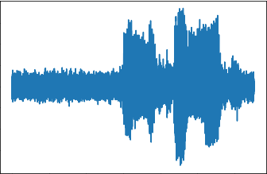
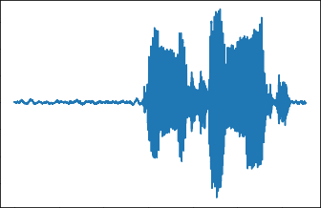
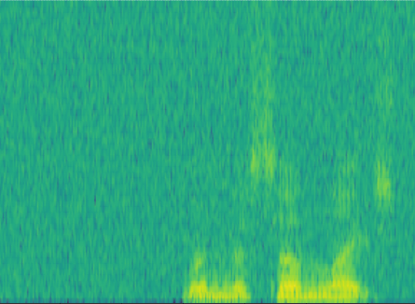
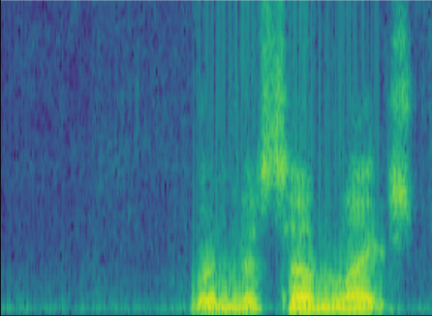
Sub-Sampler
STFT
Net
ISTFT
Loss→Update Net
Masking
Donwsampling
SDFU
CMFFU
Decoder
Input Noise
Downsampling
Encoder
Decoder
Upsampling
Output Denoised
CConv2d
SDFU
ReLU
CBN
CMFFU
CBN
RuLU
Encoder
Decoder
CDeconv2d
Encoder
SDFU
CMFFU
Decoder
CMA
Encoder
Decoder
Upsampling
Donwsampling
SDFU
CMFFU
CMA
Upsampling
Encoder
CSFU
Upsampling
Output Denoised Spectrogram
Input Noise Spectrogram
CMA
Complex Multi-scale attention Module
SDFU
Spectrum dynamic focusing Unit
Downsampling
Complex Scope Fusion Unit
Complex Multi-Scale Feature Fusion Unit
CSFU
CMFFU
Sub-Sampler
STFT
Net
ISTFT
Loss→Update Net
Masking
Donwsampling
SDFU
CMFFU
Decoder
Input Noise
Downsampling
Encoder
Decoder
Upsampling
Output Denoised
CConv2d
SDFU
ReLU
CBN
CMFFU
CBN
RuLU
Encoder
Decoder
CDeconv2d
Encoder
SDFU
CMFFU
Decoder
CMA
Encoder
Decoder
Upsampling
Donwsampling
SDFU
CMFFU
CMA
Upsampling
Encoder
CSFU
Upsampling
Input Noise Spectrogram
Downsampling
SDFU
Spectrum dynamic focusing Unit
Output Denoised Spectrogram
CSFU
Complex Scope Fusion Unit
CMFFU
Complex Multi-Scale Feature Fusion Unit

Slide 2
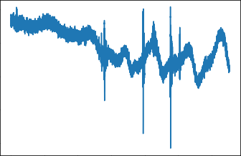
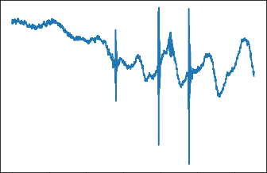

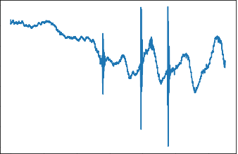
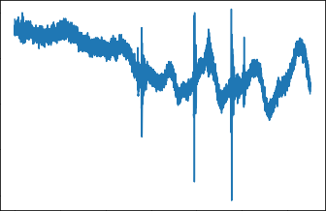

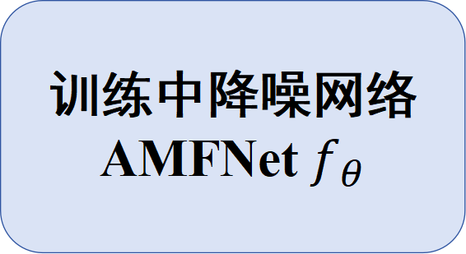
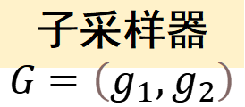
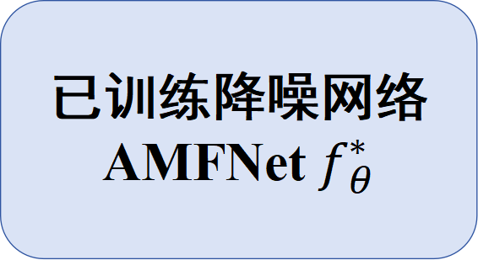
已训练降噪网络
AMFNet $f_{θ}^{∗}$
STFT
ISTFT
输入的原始音频信号
降噪后的音频信号
训练阶段
训练中降噪网络
AMFNet $f_{θ}$
STFT
ISTFT
子采样器
$$G=\left(g_{1},g_{2}\right)$$
子采样信号 y₁(t)
输出的降噪子采样信号$f_{θ}\left(y_{1}\left(t\right)\right)$
计算损失
更新网络
子采样信号 y₂(t)

Slide 3
g(1)
mask₀
0
1
1
0
1
0
0
1
...(8)
Reshape
y₁(t)
n(2)
n(3)
n(5)
n(8)
...(8)
n(t)
n(1)
n(2)
n(3)
n(4)
n(5)
n(6)
n(7)
n(8)
...(8)
g(2)
mask₁₎
1
0
0
1
0
1
1
0
...(8)
y₂(t)
n(1)
n(4)
n(6)
n(7)
...(8)
Reshape

Slide 4


网络架构
STFT
子采样信号 $y_{1}\left(t\right)$
STFT
Donwsampling
Masking
ISTFT
输出信号 $f_{θ}\left(y_{1}\left(t\right)\right)$
SDFU
Decoder
编码器结构 Encoder
Encoder
CMS-SCU
解码器结构 Decoder
CMA
SDFU
Decoder
Upsampling
Donwsampling
Encoder
CMS-SCU
CMA
Downsampling
SDFU
Decoder
Upsampling
CConv2d
Encoder
CMS-SCU
ReLU
CBN
SDFU
Decoder
CBN
RuLU
Encoder
SRU
CMS-SCU
CDeconv2d
上采样Upsampling
CMA
复数注意力模块
Upsampling
频谱动态聚焦单元
下采样Downsampling
语义重校准单元
SDFU
复数多尺度跳跃连接单元
SRU
CMS-SCU

